Slide 1
Difference Between Casual And Member Riders
Presented By: Theodore Chidi-Maha
Last Updated: june 4, 2026

Slide 2
Table of Contents
Objective statement
Data Story
Conclusion

Slide 3
Objective
Understand why there are differences between casual riders (single-ride or full-day passes) and annual members

Slide 4
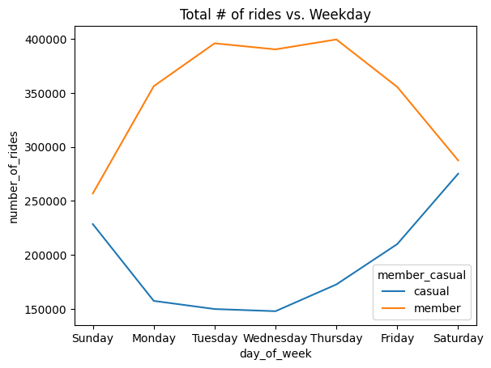
Difference in Count
As we move away from the weekend casual riders take much fewer bike trips, but members take much more.

Slide 5
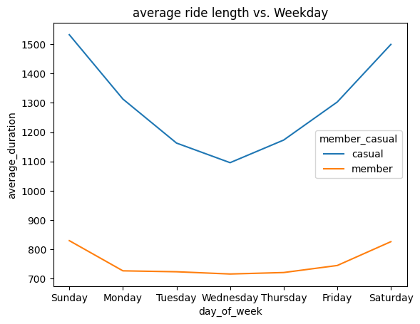
Difference in Duration
Causal rides range from ~1500-1100 secs OR ~25-18 mins
Member rides range from ~850-750 secs OR ~14-12 mins
Within the week, trip lengths for members are nearly uniform

Slide 6
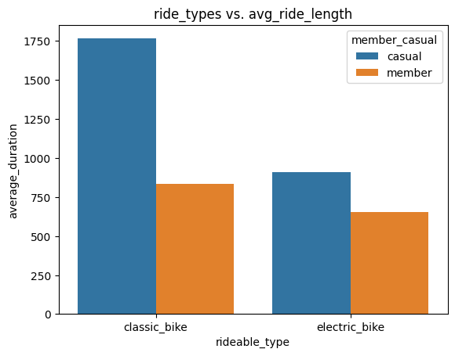
Difference in Duration
Average ride lengths vary greatly between types for causals (as expected)
However, members’ trips are similar in length irrespective of bike type
Notes:
Classic (manual) should take more energy and time than electric

Slide 7
So, where are Our users going?

Slide 8
Difference in Starting points
Sunday | Monday | Tuesday | Wednesday | Thursday | Friday | Saturday
Navy Pier | Navy Pier | Navy Pier | DuSable Lake Shore Dr & Monroe St | DuSable Lake Shore Dr & Monroe St | Navy Pier | Navy Pier
Casual:
Sunday | Monday | Tuesday | Wednesday | Thursday | Friday | Saturday
DuSable Lake Shore Dr & North Blvd | Clinton St & Washington Blvd | Canal St & Madison St | Canal St & Madison St | Clinton St & Washington Blvd | Kingsbury St & Kinzie St | Wells St & Concord Ln
Member:

Slide 9
Difference in ending points
Sunday | Monday | Tuesday | Wednesday | Thursday | Friday | Saturday
Navy Pier | Navy Pier | Navy Pier | Navy Pier | Navy Pier | Navy Pier | Navy Pier
Casual:
Sunday | Monday | Tuesday | Wednesday | Thursday | Friday | Saturday
DuSable Lake Shore Dr & North Blvd | Clinton St & Washington Blvd | Canal St & Madison St | Canal St & Madison St | Clinton St & Washington Blvd | Kingsbury St & Kinzie St | Wells St & Concord Ln
Member:

Slide 10
What’s so special about these locations?

Slide 11
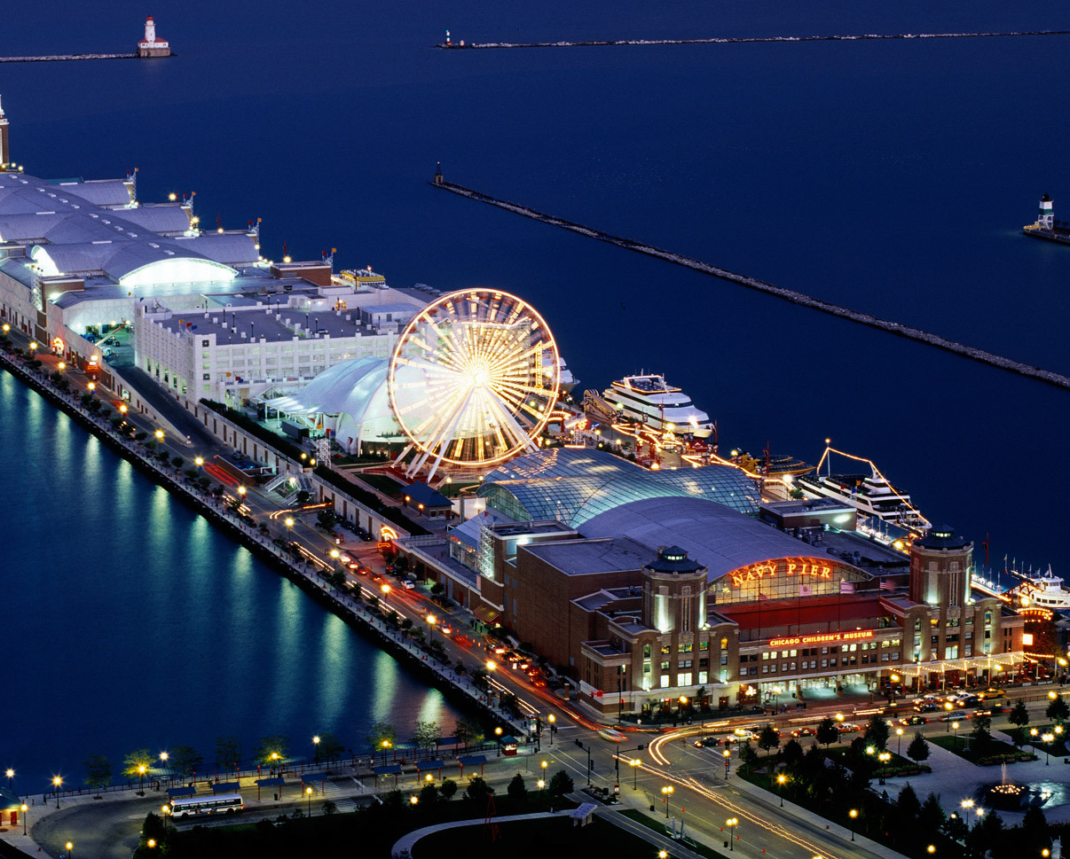
Location data - leisure
DuSable Lake Shore Dr & Monroe St - surrounded by parks and and greenery, and close to Navy pier
Navy Pier - Popular tourist attraction center
This Photo by Unknown Author is licensed under CC BY

Slide 12
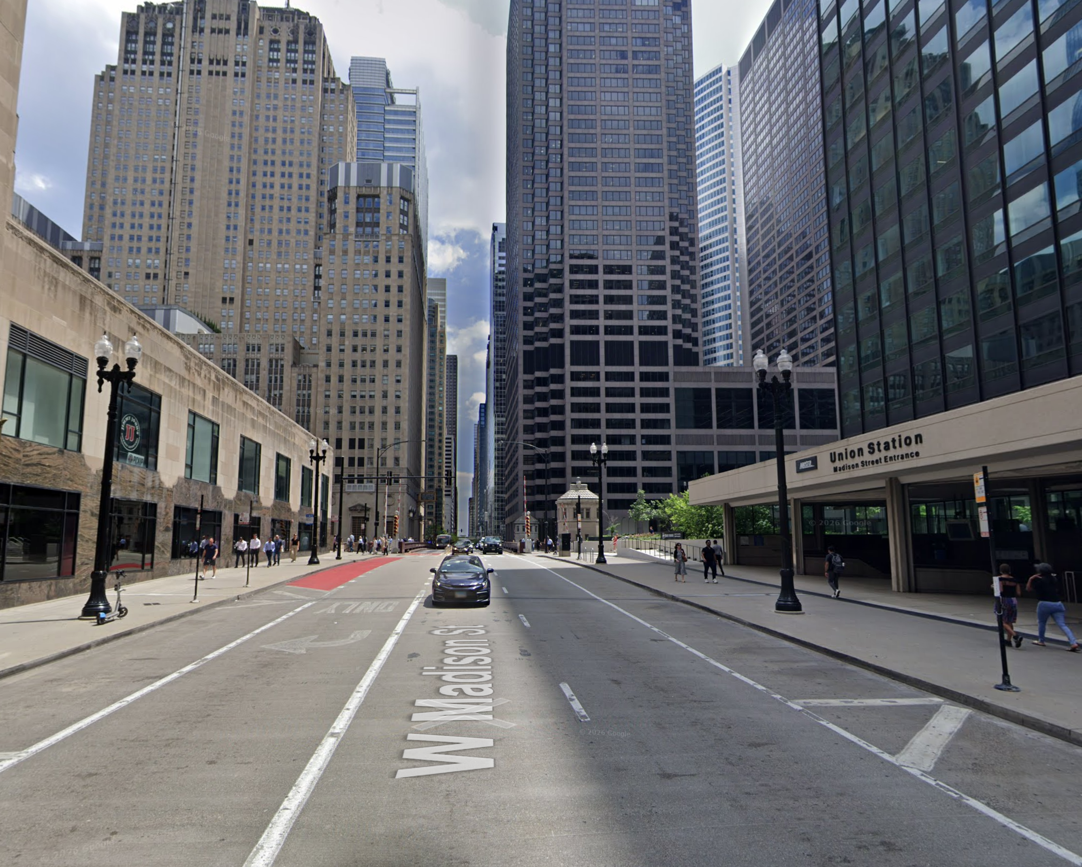
Location Data - Business
Clinton St & Washington Blvd - surround by business, in downtown Chicago
Canal St & Madison St - right in front of the subway entrance, also downtown Chicago

Slide 13
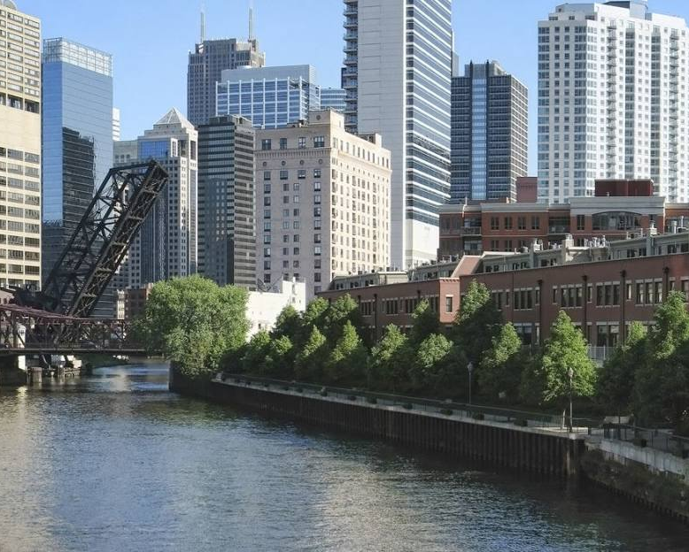
Location Data - Residential
Kingsbury St & Kinzie St - Away from the heart of the city. Between Fulton Market District and River North
Wells St & Concord Ln - outskirts of Chicago near Lincoln Park, In the Old Town Triangle

Slide 14
Conclusion
Member riders use bikes as a daily driver [to get to and from work on weekdays] and [for leisure on weekends]
Casual riders use bikes predominantly for leisure [both weekdays and weekends]

Slide 15
Follow-up/Recommendations
Identify relationship between available bikes and casual riders during the weekday
Identify how time of day affects ridership for both casual and members
The data I have access to lacks unique ID’s for users, so gather unique user data to better identify patterns between individual riders

Slide 16
Thank you

